Slide 1
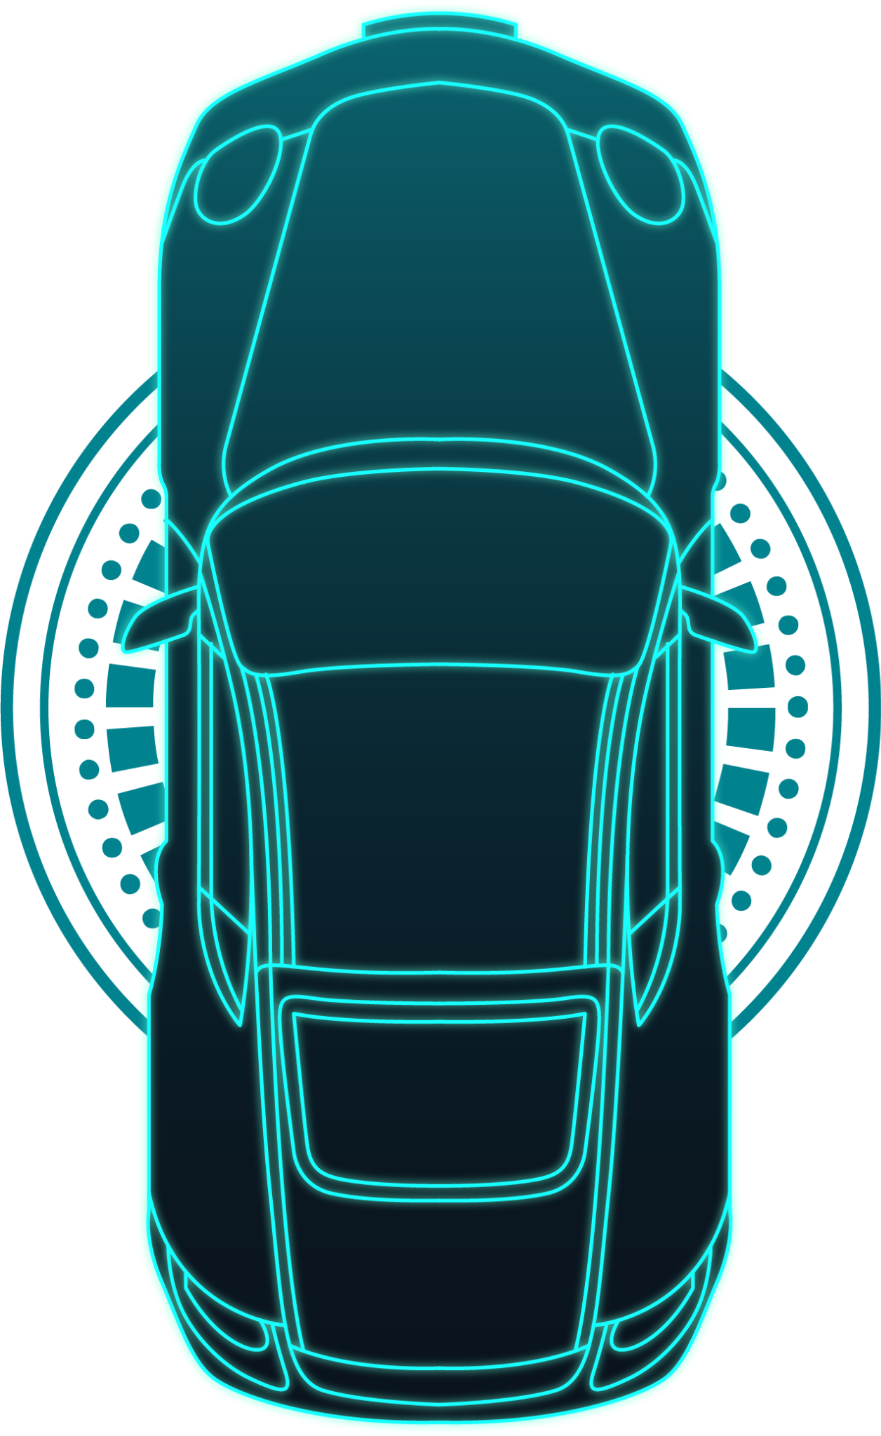
Smart Car : IoT Based Line Following Car

Slide 2
Presented by : -
03
04
01
02
Course :
Priyanshi Taliyan
Priyanshu Chaudhry
Priyanshu Jaiswal
Priyanshu Singh
Internet of Things(IoT)
Project Description :
This project demonstrates the design and implementation of an autonomous robotic vehicle that can detect and follow a predefined path using infrared sensors, a microcontroller, and a motor driver.

Slide 3
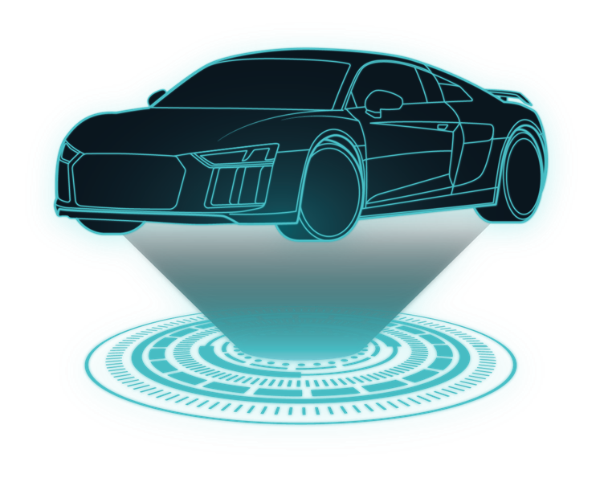
Problem Statement
In many places, transporting humas or goods from one location to another requires manual labor, which increases operational cost and the possibility of human error. An automated system is required that can follow a fixed path and move humans or goods efficiently without human intervention.
The line following robot addresses this problem by automatically detecting and following a predefined path using sensors and a microcontroller.

Slide 4
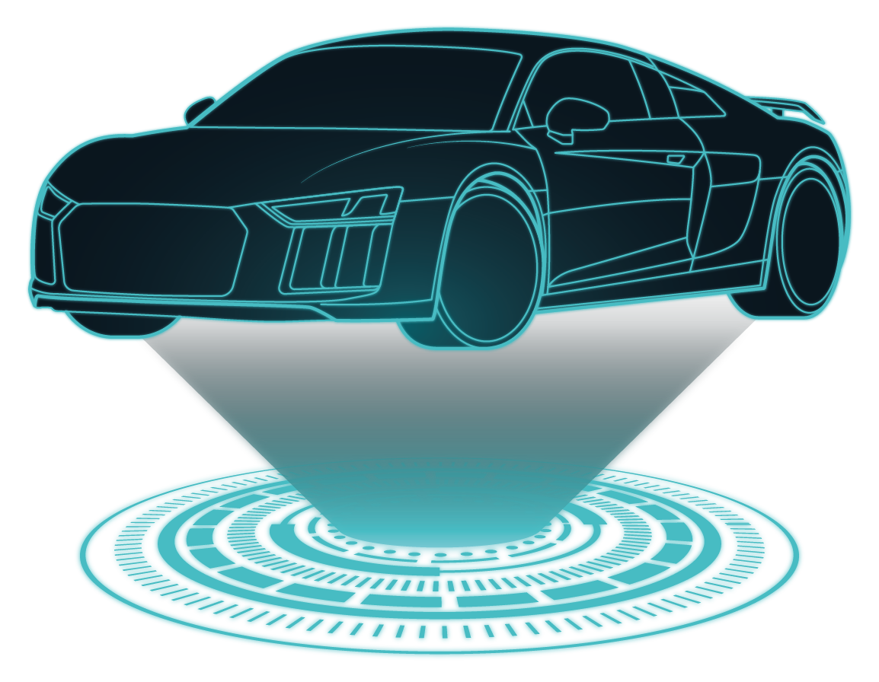
Application Areas :
Industrial automation systems
Warehouse transporation robots
Automated Guided Vehicles (AGV)
Hospital delivery robots
Airport baggage handling systems
Educational robotics and automation learning

Slide 5
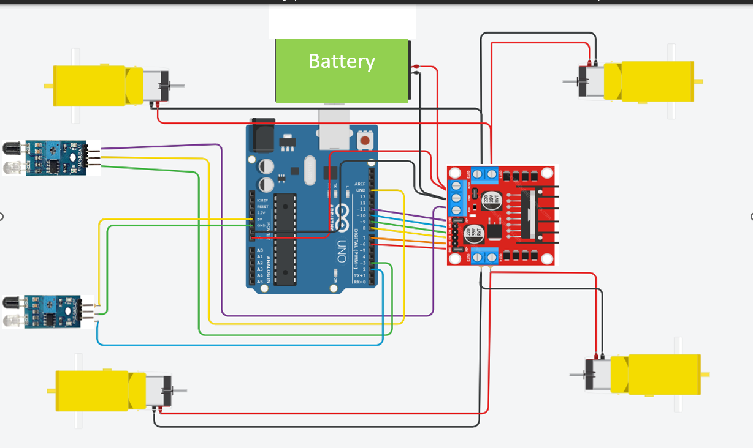
Circuit Diagram (TinkerCAD) :

Slide 6
Working Principle
The line following robot works based on infrared light reflection.
The IR sensors emit infrared light toward the surface.
White surfaces reflect more light while black surfaces absorb light.
Sensor Output :
White surface -> HIGH
Black line -> LOW
The sensors send signals to the Aurdino microcontroller.
Aurdino processes these signals and send commands to the motor driver, which controls the motors and adjust the direction of the robot.

Slide 7
Logic Used : -
Right Sensor
Robot Action
Left Sensor
LOW
LOW
Move Forward
LOW
HIGH
Turn Right
HIGH
LOW
Turn Left
HIGH
HIGH
Stop

Slide 8
Code Explanation :
Functions Used in the Code (Bullet Points)
1. setup()
a) Runs once when the Arduino starts.
b) Initializes pin modes and starts serial communication.
2. loop()
a) Main function that runs continuously.
b) Reads sensor values and decides the robot’s movement.
3. moveForward()
a) User-defined function.
b) Moves the robot forward by rotating both motors in the forward direction.

Slide 9
4. turnRight()
User-defined function.
Turns the robot to the right by reversing the left motor and moving the right motor forward.
5. turnLeft()
User-defined function.
Turns the robot to the left by moving the left motor forward and reversing the right motor.
6. stopMotors()
User-defined function.
Stops both motors by setting motor speed to zero.
7. digitalRead()
Built-in Arduino function.
Reads the HIGH or LOW signal from the IR sensors.

Slide 10
8. digitalWrite()
a) Built-in Arduino function.
b) Sends HIGH or LOW signals to motor driver pins to control motor direction.
9. analogWrite()
a) Built-in Arduino function.
b) Generates PWM signals to control motor speed.
10. delay()
a) Pauses the program for a specific time in milliseconds.
11. Serial.begin()
b) Starts serial communication between Arduino and computer.
12. Serial.print() / Serial.println()
a) Displays sensor values and messages in the Serial Monitor for debugging.

Slide 11
Result
The designed line following car successfully detects and follows a predefined path marked with a black line on a white surface.
The IR sensors continuously monitor the line position, and the Aurdino processes this data in real time to adjust motor movement.
Observed Output
Car moves forward when both sensors detect line.
Car moves left or right when the line shifts under one sensor.
Robot stops when no line is detected.

